Slide 1
Diseases of the urinary tract and the male reproductive system. Pyelonephritis. Urolithiasis. Diseases of the prostate gland. Tumors of the kidney, bladder and prostate.
Department of Pathological Anatomy OrSMU
Theme of the lecture:

Slide 2
Pyelonephritis – nonspecific infectious-inflammatory disease, with the combined primary inflammatory lesions pyelocaliceal system, tubular apparatus, and interstitial kidney.
N.B! Glomerular kidney in pyelonephritis remains intact or damaged secondary to progressive generalized inflammation of the interstitium and tubules.

Slide 3
Classification of the pyelonephritis
I. Involvement in the process of one or both kidneys:
The unilateral pyelonephritis
The bilateral pyelonephritis
II. With the flow:
Acute pyelonephritis
Chronic pyelonephritis:
      Obstructive
      Reflux

Slide 4
The etiology of pyelonephritis
E. Coli (the most frequent cause)
Proteus
Enterobacter
Klebsiella
Staphylococcus (more frequently when under way hematogenous infection)

Slide 5
Ways penetration of an infection
Ascending (urinogenous)
Hematogenous (septicemia, tonsillitis, furunculosis, and others).
Lymphogenous (with the inflammation of the colon and genital organs)

Slide 6
The predisposing factors
Violation of hygiene
Hypothermia
Genetic predisposition
The short length of the urethra
Female gender (because of the proximity of the vagina and anus)
Mechanical trauma of the urethra (for example catheterization or cystography)
Pregnancy

Slide 7
Precipitating (causing) factors :
the presence of pathogens;
infection urine;
dyskinesia ureter and renal pelvis;
difficulty of outflow of urine and an increase in pressure inside the pelvis (inside his cause stones, stricture urethra and ureters, abnormalities of the urinary tract; outside - the tumors, the pregnant uterus);
Vesico-ureteral reflux (regurgitation of infected urine into the ureter to the renal pelvis and calyx);
Intrarenal reflux (bacteria from entering through the renal papillae in the renal parenchyma).

Slide 8
Acute pyelonephritis:
Macroscopically. Kidney enlarged, swollen, full-blooded, it is easy to remove the thickened capsule. Cavities pelvis and calyx expanded in the lumen - cloudy urine or pus. The mucous membrane of the pelvis and calyx dim, hyperemic, with foci of hemorrhage, necrosis and grayish fibrinous raids. On the visible surface of the kidney subcapsular small abscesses. In a cut the renal parenchyma motley (gray and yellow areas of necrosis and suppuration, hemorrhage).

Slide 9
Acute pyelonephritis:
Microscopically. The mucosa of the pelvis and calyx noticeable hyperemia, hemorrhage, leukocyte infiltration with necrosis and desquamation of the epithelium. The interstitial tissue edema of all layers of the kidney, foci of hemorrhage, multiple perivascular leukocyte infiltrates with a tendency to the formation of abscesses. The pus and bacteria from the interstitial tissue penetrate into the lumen of the tubules. Miliary abscesses in cortex are characteristic apostematose hematogenous jade. The simultaneous occurrence of pustules and medulla due to embolism capillaries around the tubules. Collecting ducts are often filled with neutrophils.

Slide 10
Acute pyelonephritis. On the surface of the kidney seen multiple abscesses

Slide 11
Acute pyelonephritis. Severe congestion of the mucous membrane pelvis and cups. Multiple small abscesses in the cortex

Slide 12
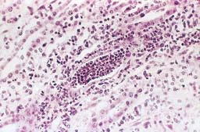
Acute pyelonephritis. In the interstitium and tubular lumen there is neutrophilic infiltration

Slide 13
Outcomes of acute pyelonephritis
Convalescence
Becomes chronic
Complications
Death from complications

Slide 14
Complications of acute pyelonephritis
Carbuncle kidney
Pyonephrosis
Perinephritis and Paranephritis
Papillonecrosis (often in older diabetics when urinary stasis)
Acute renal insufficiency
Sepsis (up to septic shock and metastatic spread of purulent infection)

Slide 15
Carbuncles kidney

Slide 16
Diabetic kidney with pyelonephritis and papillary necrosis.

Slide 17
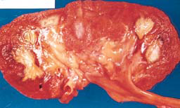
Papillary necrosis

Slide 18
Пионефроз

Slide 19
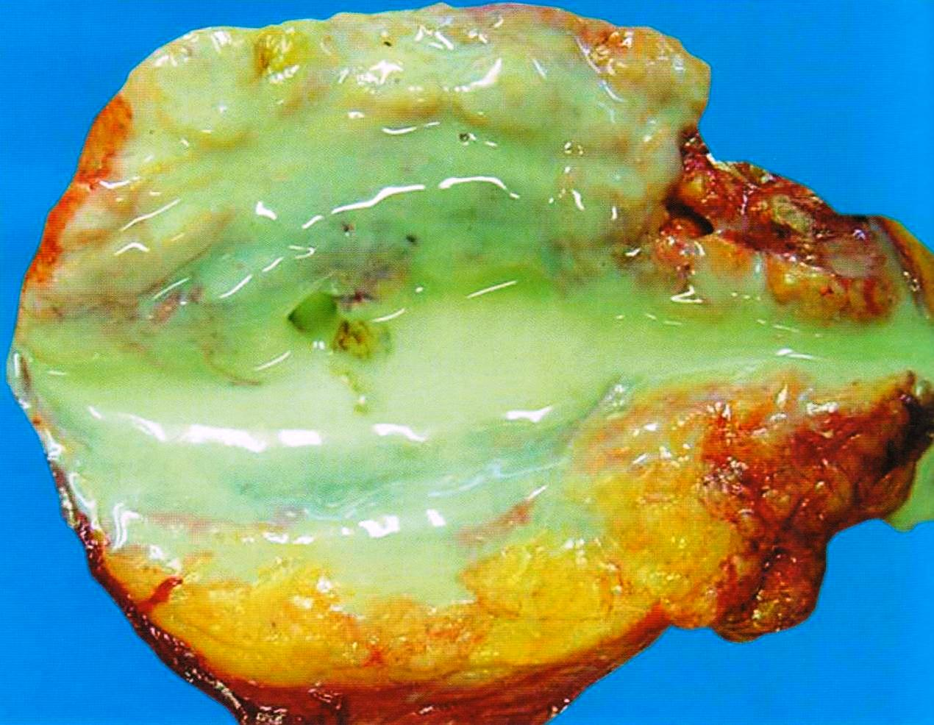
Pyonephrosis

Slide 20
Chronic reflux pyelonephritis (Reflux nephropathy)
А. Vesicoureteral reflux
Б. Intrarenal reflux
Б
А

Slide 21
Chronic pyelonephritis:
Macroscopically: characterized by destructive changes pyelocaliceal system and renal scarring. At the beginning of kidney diseases sizes are not changed, then there is a progressive reduction and deformation. Sizes kidney unequal, their surface with large bumps, thickened capsule is removed with difficulty with the loss of renal substance (due to the formation of dense commissures). In the section - sclerosis (thickening and compaction of the walls) and the deformation of the pelvis, the field of scar tissue grayish among unaltered renal parenchyma.

Slide 22
Chronic pyelonephritis :
Microscopically. In the kidney tissue between the portions visible intact parenchymal sclerosis, encapsulated microabscesses, lymphocytic infiltration. Tubules able dystrophy and atrophy. The preserved tubules greatly stretched their epithelium is flattened, in the lumen - like the colloid content (thyroid kidney). Characterized glomerulosclerosis (extracapillary and periglomerulary), sclerosis of the arteries and veins. Also, in the renal pelvis and calices observed sclerosis, lymphocytic infiltration, polyposis mucosal, metaplasia transitional epithelium in the stratified squamous epithelium.

Slide 23
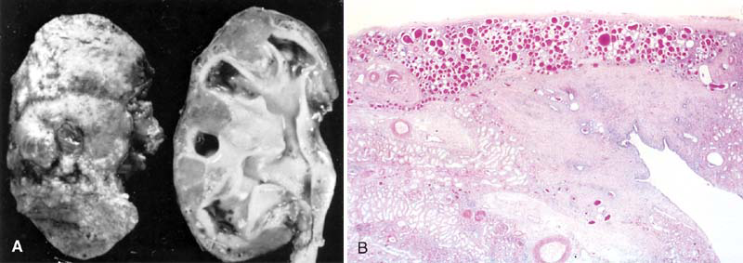
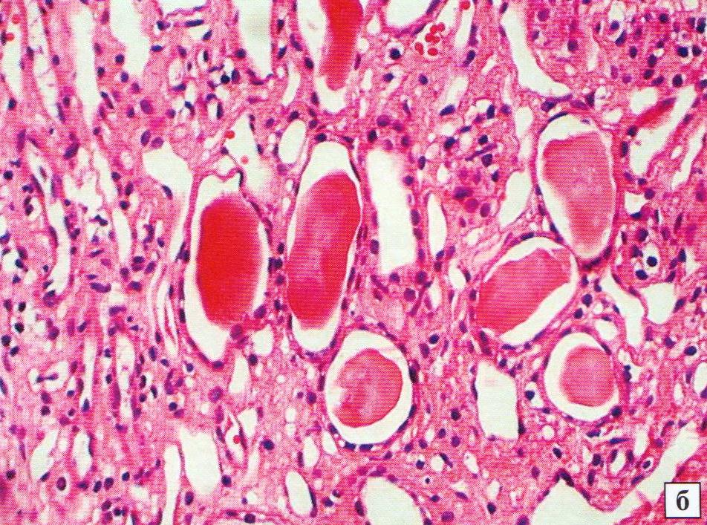
. Chronic pyelonephritis. The surface is uneven kidney. Pyelocaliceal system expanded. "Thyroidization" tubules in the cortex.

Slide 24
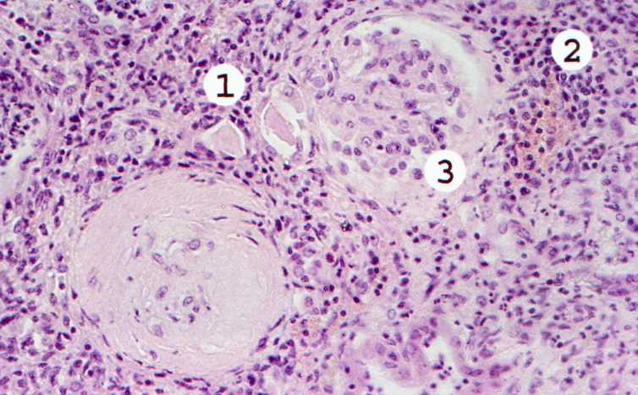
  Chronic pyelonephritis. Some tubules constricted, most expanded, filled with colloid-cylinder (1). In the interstitial diffuse sclerosis, focal and diffuse lymphohistiocytic infiltrate with admixture of neutrophils (2). Severe periglomerular sclerosis (3).

Slide 25
Outcomes of chronic pyelonephritis
Convalescence (rare in the early diagnosis and lengthy therapy)
The development of complications (the same as in acute pyelonephritis)
Pyelonephritiс contracted kidney and chronic renal insufficiency
Death from complications and chronic renal insufficiency

Slide 26
Urolithiasis — disease to form in the urinary tract calculi (stones), formed from the components of the urine.

Slide 27
Common causes of stone formation:
congenital and acquired metabolic disorders (primarily mineral metabolism, acid-base balance);
the nature of power (the predominance of carbohydrates and animal protein);
mineral composition of drinking water (endemic nephrolithiasis);
dysregulated metabolism (hyperparathyroidism);
lack of vitamins (vitamin deficiency A);
excess vitamins (hypervitaminosis D)
Local causes of stone formation:
violation of urodynamics (slowing of renal blood flow, urine stagnation);
inflammation of the urinary tract, tubulopathy (oksalaturiya, phosphaturia, etc.);
changes in physico-chemical state of urine (increased salt concentration, pH change, colloidal equilibrium).

Slide 28
Factors predisposing to urolithiasis
Endogenous factors:
malignant neoplasms;
sarcoidosis;
gout;
diseases of kidneys and intestine.
Exogenous factors:
work at high temperatures;
dehydration;
a diet high in oxalate, purines, calcium, vitamins, animal proteins;
receiving thiazide diuretics;
sedentary lifestyle.

Slide 29
Species composition of kidney stones
Urate stones (not visible on X-ray) - of calcium salts of uric acid, pale yellow or dark brown. Formed only in acidic urine.
Calcium oxalate stones (visible on X-ray) — of calcium salt of oxalic acid, brown or black, very thick, the surface is covered with spines. Formed both in acidic and in alkaline urine; can damage the mucous membrane of the pelvis, causing hematuria.
Calcium phosphate stones (visible on X-ray) — of calcium salts of phosphoric acid, grayish-white, softer than oxalate. Formed in alkaline and neutral urine.
Struvite stones (MgNH₄P0₄) - It occurs when urinary tract infection bacteria synthesizing urease (eg, Proteus kind of), more often in women, or patients with chronic urinary catheterization. For such stones are used, the term "infectious stones." Struvite stones grow large, filling the pelvis and calyx (coral stone).
Other (rare) stones: cystine, xanthine, cholesterol, protein stones.

Slide 30
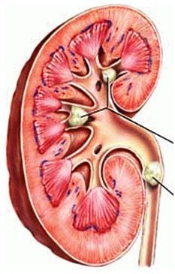
Kidney stones

Slide 31
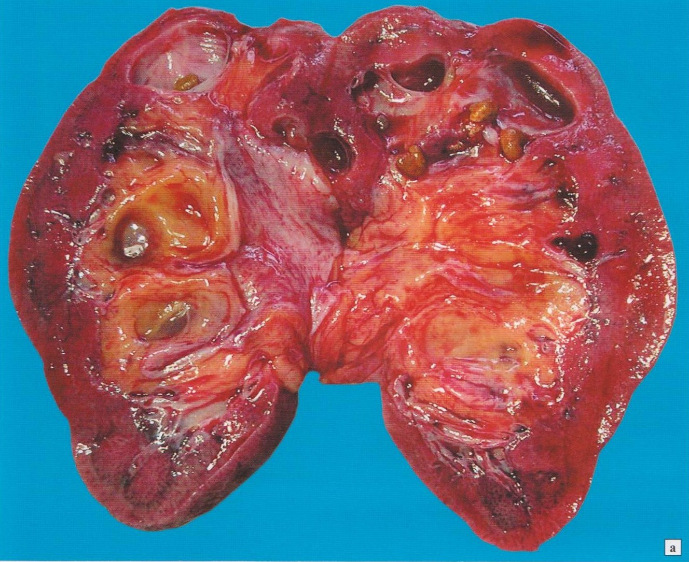
Kidney stones with the development of hydronephrosis

Slide 32
Complications of urolithiasis
bedsores and perforations pelvis and / or ureter;
hydrocalycosis;
hydronephrosis;
hydroureteronephrosis
urethritis;
pyelonephritis;
pyonephrosis;
urosepsis;
acute renal insufficiency
chronic renal insufficiency

Slide 33
Urate nephropathy — disease as a result of which, is the deposition of crystals of uric acid or its salts (sodium urate) in the lumens of tubules or interstitium of renal.

Slide 34
Classification of urate nephropathy
I. On causation:
Primary - associated with defects in the enzymes uric acid synthesis.
Secondary - develops when excessive cellular debris (blood diseases, chronic hemolysis, chemotherapy), as well as in chronic lead intoxication (impaired secretion of uric acid in the proximal tubule).
II. With the flow:
Acute - associated with the treatment of cancer with cytostatics. Increased hepatic catabolism of purines, DNA released from necrotic cells, leading to hyperuricemia. Obstruction of collecting tubules crystals of uric acid causes the development of acute renal insufficiency.
Chronic - it caused by the deposition in the tubules and interstitium of sodium urate in the long forms of hyperuricemia

Slide 35
The classification of renal tumors
I. Benign
Epithelial:
  Adenoma: dark cell (basophilic), clear cell and acidophilic (oncocytomas)
Mesenchymal:
  Fibroma (hamartoma)
  Angiomyolipoma
  II. Malignant
Epithelial:
  Renal cell carcinoma (hypernephroma): clear cell (alveolar); glandular (adenocarcinoma); granular cell; polymorphocellular (sarcomatoid, aggressive carcinosarcomas); mixed cell carcinoma
Mesenchymal :
  Mesenchymal:
  Leiomyosarcoma
Mixed structure:
  Nephroblastoma (embryonal carcinosarcoma, Wilms' tumor, adenosarcoma)

Slide 36
Risk factors for kidney cancer
Smoking tobacco — (3-fold increase in the incidence of)
The action of chemical and biological carcinogens —nitrosamines, aromatic amines, thorium oxide and asbestos.
Drugs — the use of hormones and cytostatics
The radiation
Adiposity
Multicystic kidney disease
Prolonged hemodialysis

Slide 37
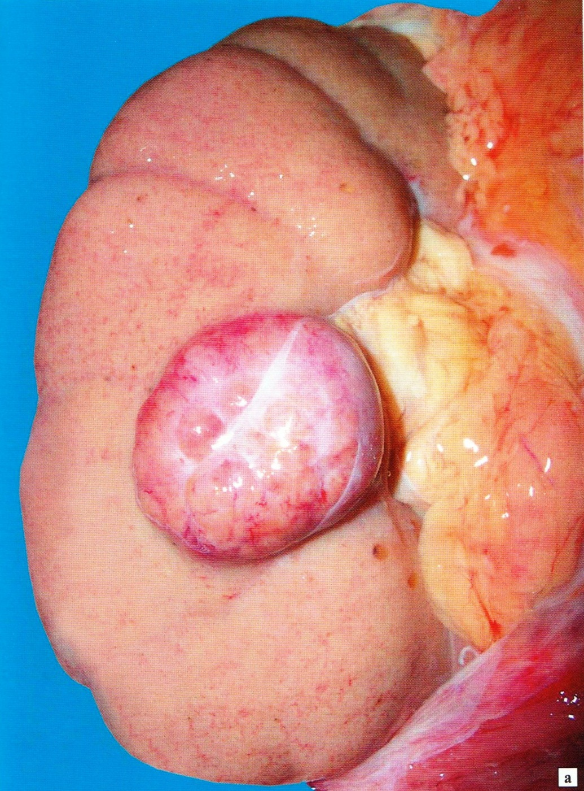
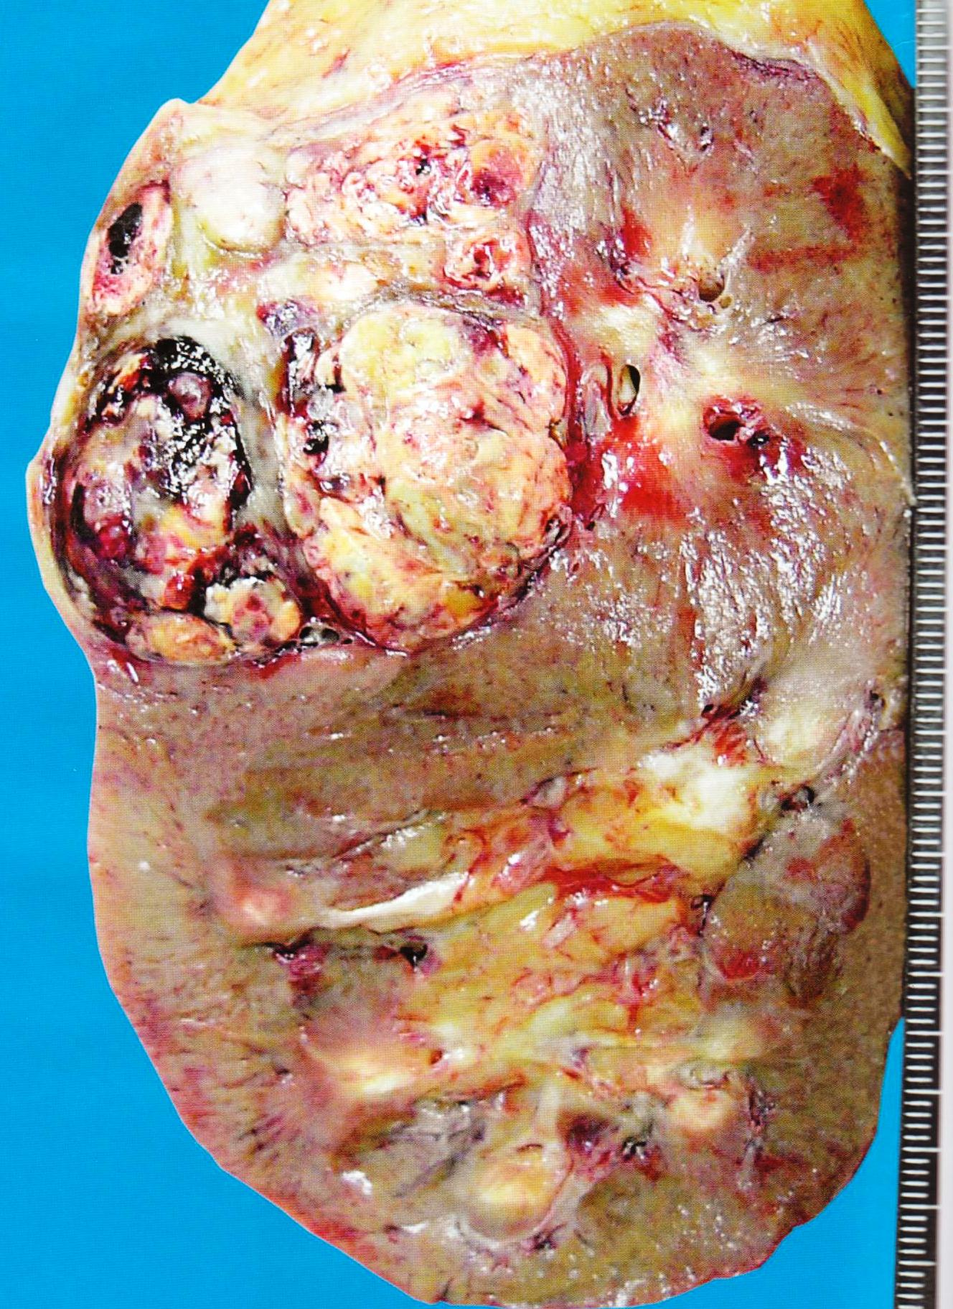
Renal cell carcinoma (hypernephroma)

Slide 38
Nephroblastoma (Wilms tumor, adenosarcoma)

Slide 39
The classification of bladder tumors
I. Benign
The epithelial:
  Transitional cell papilloma
  The inverted papilloma
The mesenchymal :
  Leyomioma
  Gemangioma
  Lipoma
II. The malignant
The epithelial:
  Transitional cell cancer
  Squamous cell carcinoma
  Adenokarcinoma
The mesenchymal :
  Leyomiosarcoma
  Fibrosarcoma

Slide 40
Risk factors of development of a cancer of bladder
Tobacco smoking — (increases the frequency of development of a cancer of bladder by 2-7 times).
Effect of chemical and biological carcinogens — the industrial carcinogens applied in rubber, paint and varnish, paper and chemical production (arilamina etc.).
The drugs — cyclophosphamide (increases 10 times the incidence of bladder cancer), phenacetin, and others.
Chronic inflammation (including bilharziasis in schistosomiasis) with the development of hyperplasia and metaplasia, and dysplasia of the bladder mucosa.
Chronic alcoholism
The synthetic sugar substitutes (saccharin and cyclamate).
Excess and long use of coffee or caffeine

Slide 41
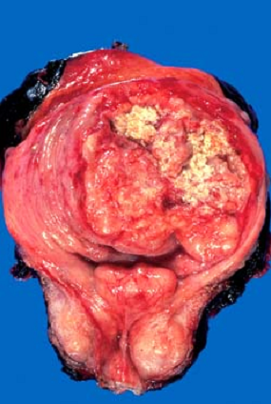
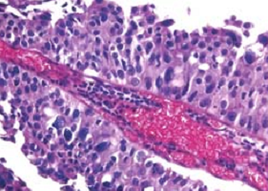
Papillary transitional cell cancer bladder

Slide 42
Prostatitis — group of the inflammatory diseases of a prostate gland differing with an etiology, pathogenesis, prevalence, a current and features of clinical and morphological manifestations.

Slide 43
Classification of prostatitis
I. Acute bacterial prostatitis (Escherichia coli, Enterobacteriaceae, Neisseria gonorrhoeae, Trichomonas vaginalis)
  Catarrhal form
  Follicular form
  Parenchymatous form
II. Chronic bacterial prostatitis (Chlamydia trachomatis, Trichomonas vaginalis, Mycoplasma, Ureaplasma urealyticum)
III. Granulomatous prostatitis (syphilis, tuberculosis and fungal infections)
IV. Chronic not bacterial prostatitis (unknown etiology)

Slide 44
The factors predisposing to prostatitis
Acute prostatitis:
infection of urinary tract;
sexually transmitted disease (STD);
general overcooling;
Chronic prostatitis:
Acute prostatitis;
infection of urinary tract;
long sexual abstention;
the interrupted sexual intercourses;
hypodynamia;
alcoholism.

Slide 45
Acute prostatitis
Macroscopically. The prostate is increased in a size, full-blooded. On a section a parenchyma motley (gray-yellow sites of a necrosis and suppuration, hemorrhage).
Microscopically. Allocate 3 forms (stage):
◊ Catarrhal form. Develops pronounced neutrophilic infiltration ductal prostate glands background hyperemia of vessels and edema of the stroma.
◊ Follicular form. To the changes ducts join foci of inflammatory infiltration in the prostate secretory departments.
◊ Parenchymatous form. The diffusion infiltrates consisting mainly of neutrophils are formed, there are abscesses and the foci of granulation.

Slide 46
Chronic prostatitis
Macroscopically. The prostate is increased in sizes, compacted, deformed.
Microscopically. In the stroma inflammatory foci containing lymphocytes, plasma cells and macrophages. Often reveals proliferation of granulation and fibrous tissue with glands atrophy.
Complications of prostatitis:
Urinogenous sepsis
Urinary retention.
Recurrent urinary tract infections
Barrenness

Slide 47
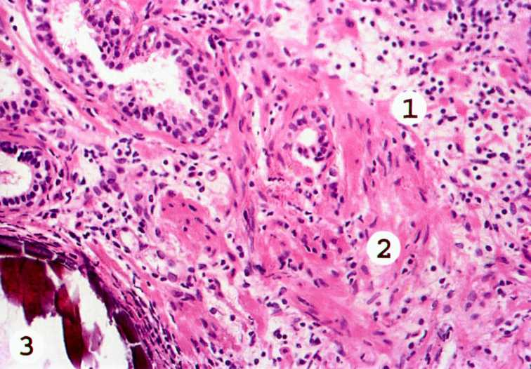
  Chronic prostatitis. In an interstition — diffusion and focal infiltrates from lymphocytes and macrophages, with impurity of neutrophils (1) Places note a sclerosis an interstition, gland in the these areas atrophic (2). The center of a petrifikation is visible (3)

Slide 48
Classification of tumors of a prostate
I. The benign
The epithelial:
  Benign nodular hyperplasia
  Basal cell hyperplasia
  Prostatic intraepithelial neoplasia (dysplasia)
The mesenchymal:
  Leiomioma
  Fibroma
II. The malignant
The epithelial:
  Adenocarcinoma: (ductal, acinar, slime, signet ring cell)
  Squamous cell carcinoma
  Transitional cell carcinoma
  Adenosquamous cancer
  Undifferentiated (anaplastic) cancer.
The mesenchymal :
  Leyomiosarcoma
  Fibrosarcoma

Slide 49
The benign nodular prostatic hyperplasia (BPH) — dishormonal parts periurethral prostatic disease characterized by an increase in the size of the prostate, leading to obstruction of the bladder outlet and proximal urethra.
In Russia now BPH occurs in 25% of European race men after 50 years, at 50% — after 60 years, and after 70 years — at 90% of men.

Slide 50
The classification of benign nodular hyperplasia of the prostate
I. The glandular form:
  The simple - the most common form and is characterized by the developed rounded, extended (up to the appearance of small cysts), branched acini forming lobular structure. They predominate over the stroma, lined with a single layer of prismatic epithelium of varying heights
  The papillary - a significant number of structures in the papillary hyperplastic acini.
  The cribriforme - a significant number of lattice structure in the hyperplastic acini.
  II. The stromal form - dominated by stromal elements, and in some cases loose fibromuscular stroma forms nodules containing no glands.
  III. The mixed form:
  glandular-fibrous
  glandular-fibromuscular
  musculo-glandular
  musculo-fibrous

Slide 51
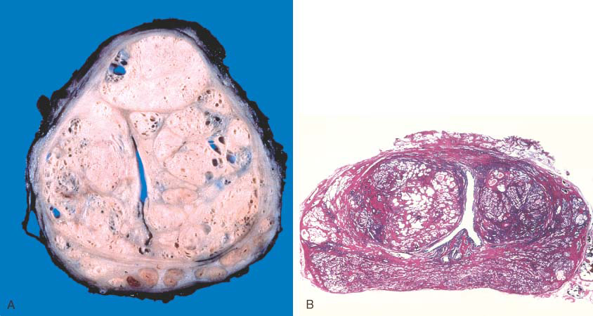
The benign nodular hyperplasia of the prostate. The sizes of gland are increased, on a section yellow-white knots with a clear boundary.

Slide 52
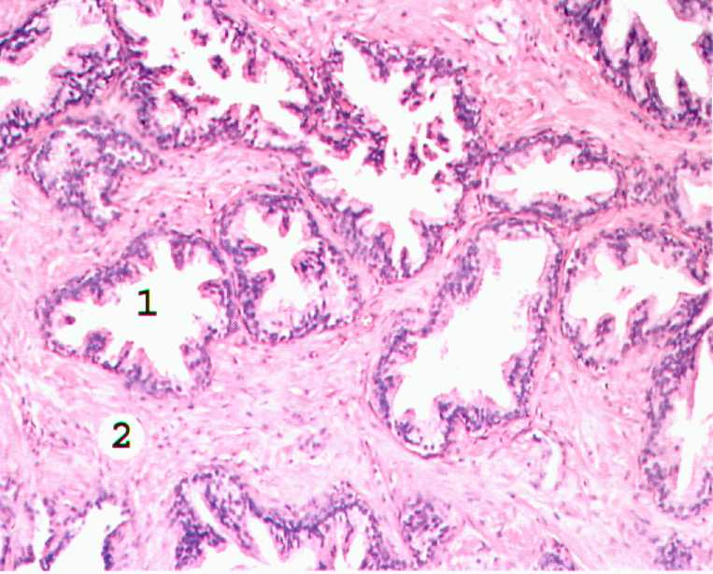
  The benign nodular hyperplasia of the prostate, glandular-fibrous form.
  Hyperplasia glands and stroma of the prostate. Mostly gland form cysts lined with flattened epithelium in some glands epithelium forms papillae (1). In the stroma - focal lymphocytic-macrophage infiltration (2).

Slide 53
Complications of the benign nodular hyperplasia of the prostate:
compression and deformation of the urethra and bladder neck - obstruction of urine outflow;
hydroureteronephrosis
infection of residual urine;
pyelonephritis;
pyonephrosis;
urosepsis;

Slide 54
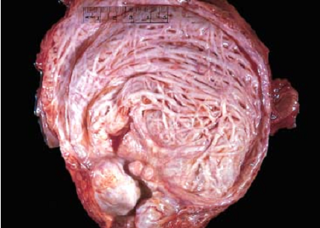
  Hypertrophy of the bladder wall in benign nodular prostatic hyperplasia

Slide 55
Risk factors of development of a prostate cancer
Age
Disgormonalny changes
Genetic predisposition
Effect of chemical and biological carcinogens (arilamina, nitrosamines, etc.)
Viral infection (virus of simple herpes, cytomegalovirus)
Excess of fats in food
Chronic prostatitis
Hyperinsolation in people of European race

Slide 56
Prostate cancer morphology
Macroscopically. It is characterized by existence in a prostate of multiple dense knots of yellow-white color, localized on the periphery of gland and under a capsule. The tumor is capable to sprout in seminal vesicles, and at late stages of a disease — in a bladder.
Microscopically. Most often comes to light adenokarcinoma prostate gland for which formation of complexes of atypical glands of the averages and the small sizes which are usually covered by monomorfny cages of a cubic or cylindrical form is characteristic. Sometimes options meet adenokarcinoma with papillary or cribriforme structures.

Slide 57
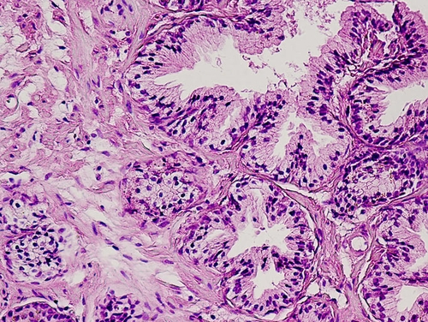
  The prostatic intraepithelial neoplasia is high degree of malignancy.

Slide 58
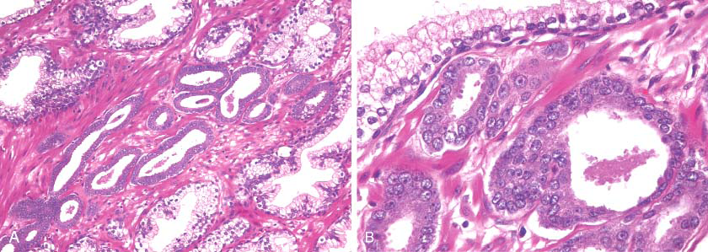
  Adenokarcinoma prostate gland

